Slide 1
Welcome to Marketing Management
Dr. Cecilia Ruvalcaba
BUSI 107 Week 9, Day 2

Slide 2





Notes:
http://money.cnn.com/2016/03/23/investing/nike-earnings-stock-drop-under-armour/index.html?iid=hp-stack-dom
http://money.cnn.com/2016/03/17/technology/nike-auto-lacing-sneaker-hyperadapt/index.html?iid=EL

Slide 3
Pricing Strategy

Slide 4



Pricing Strategies
Cost-Based
Start with Cost
Calculated per-unit
Assumes costs don’t vary
Competition Based
Set prices to signal how products compare with competitors
Similar Price -> Similar Product
Higher Price -> Greater Quality/Value
Value-Based
Perceived Value
Consumer Perceptions

Slide 5
Common Pricing Strategies: Everyday Low Pricing vs. High/Low Pricing
Create value in different ways
EDLP saves search costs of finding lowest overall prices
High/low provides the thrill of the chase for the lowest price

Slide 6

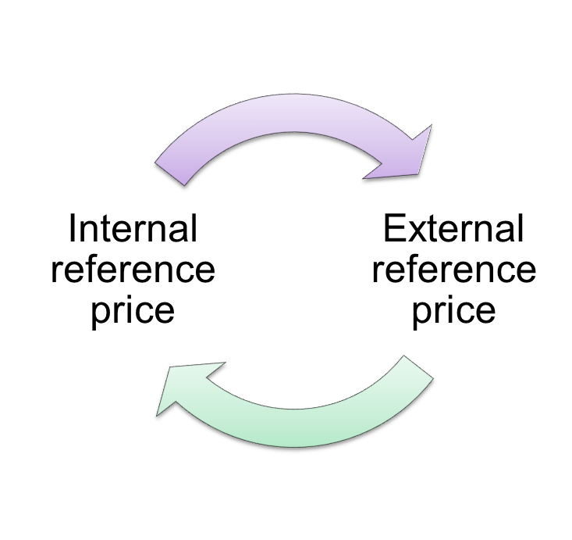

High/Low Pricing: Reference Prices

Slide 7
New Product Pricing
Price Skimming
Market Penetration Pricing

Slide 8
Pricing Tactics
Mark downs
Quantity Discounts
Seasonal Discounts
Coupons
Rebates
Leasing
Price Bundling
Leader Pricing

Slide 9
Psychological Factors
Prestige Pricing
Involves charging a high price to create a signal that the product is exceptionally fine
Odd Pricing
Prices are set at one or a few cents or dollars below a round number in order to create the perception that the price is low
Bundle Pricing
Involves selling several products together at a single price in order to suggest a good value
Companion Pricing
Products whose sale is dependent upon the sale of primary product
Display Perception
The Value of 9
Available Alternatives
In-Store Displays
Anchoring
Comparison
Time vs. Money
Framing
Notes:
Dan Ariely:
Are we in control of our own decisions? (18 min)
http://www.ted.com/talks/dan_ariely_asks_are_we_in_control_of_our_own_decisions?language=en

Slide 10
Designing to Cost
The Target-Costing Process
Determine the segment(s) to be targeted, as well as the prices that customers in the segment will be willing to pay.
Compute overall target costs with the aim of ensuring the company’s future profitability.
Allocate the target costs to the product’s various functions. Calculate the gap between the target cost and the estimated actual production cost.
Obey the cardinal rule: If the design team can’t meet the targets, the product should not be launched.

Slide 11

Tips for Pricing Strategy
Base Pricing strategies on sound research.
Continuously monitor pricing decisions.
Recognize that buyers may have difficulty in computing price differences.
Recognize that customers evaluate prices comparatively.
Recognize that buyers typically have a range of acceptable prices.
Understand the importance of relative price to buyers.
Understand the importance of price information.
Recognize that price elasticities vary.

Slide 12


Take Away for Today
Pricing for the Customer
What is their reference price?
Deciding on a tactic- what is the end goal?
Designing to Cost
Advantage or Disadvantage…

Slide 13

Next Class
Exam 2 (Chapters 4, 11-15) Friday 3/25
Week 10- Managing Channels!

